Slide 1

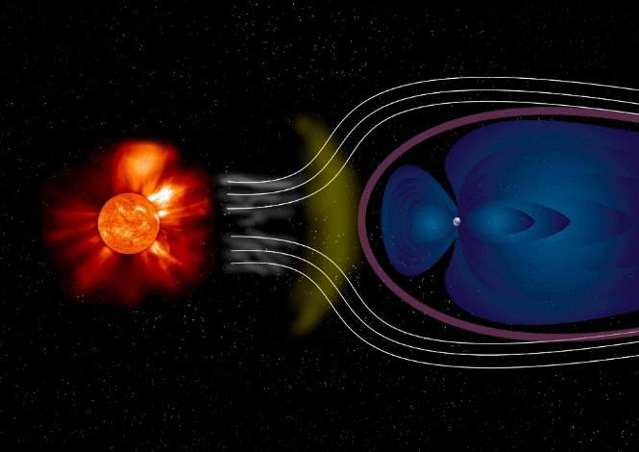
Electromagnetics
# 2
G. M. Parsanasab
References:
[1] David J. Griffiths, Introduction to Electrodynamics-Cambridge University Press (2017).
[2] Cheng, David Keun, Field and wave electromagnetics-Pearson New international ed. (2013_2014).
[3] Purcell E.M., Morin D.J. - Electricity and Magnetism-Cambridge University Press (2013).
[4] Jr. George Brinton Thomas, Christopher Heil, Joel Hass, Przemyslaw Bogacki, Maurice D. Weir, University calculus, early transcendentals (2020).

Slide 2
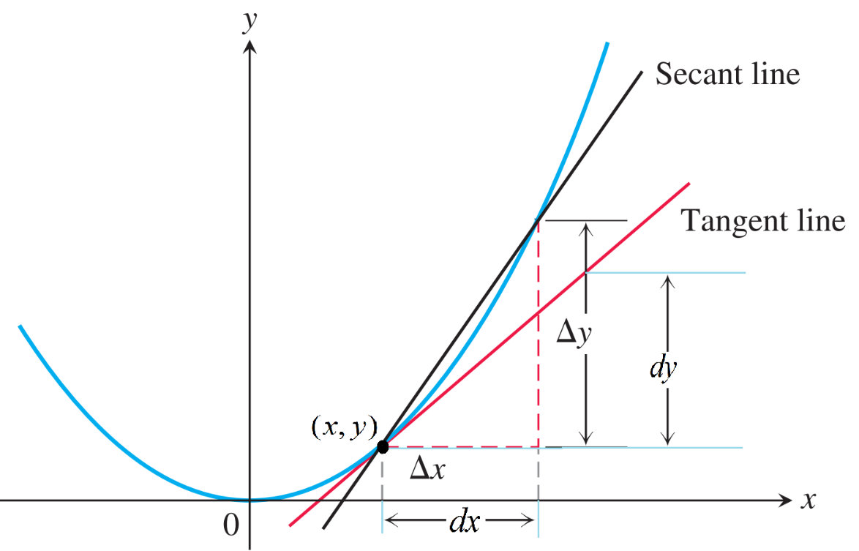
1.2 DIFFERENTIAL CALCULUS
“Ordinary” Derivatives
The derivative df/dx is the slope of the graph of f versus x.

Slide 3
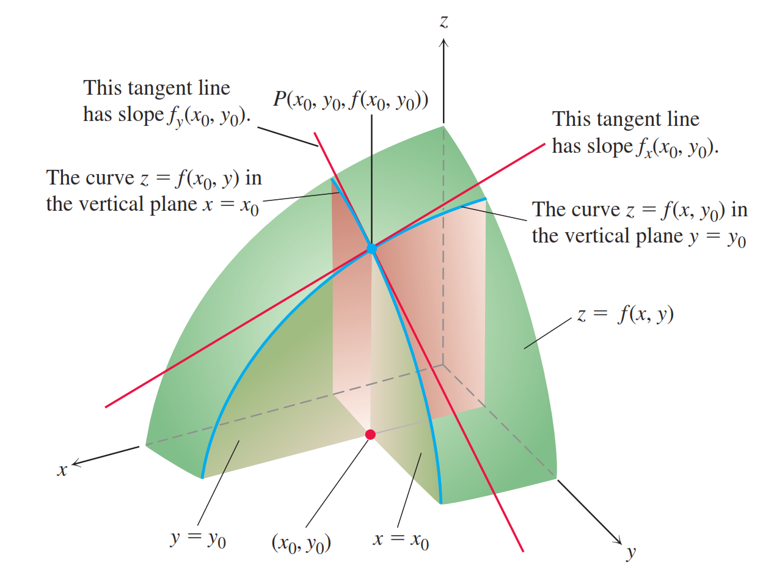
Gradient

Slide 4
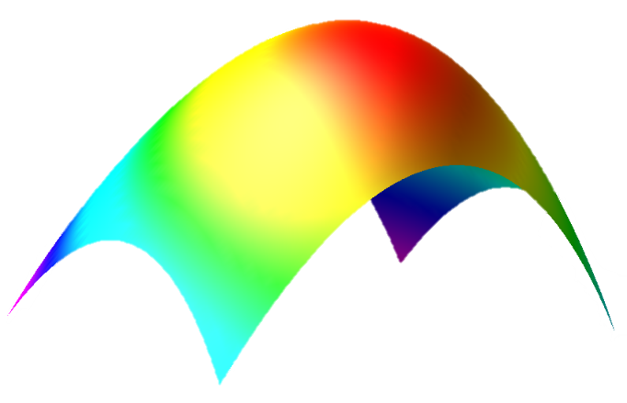
Gradient (2D)
Z
Y
X

Slide 5
Gradient (2D)
Z
Y
X

Slide 6
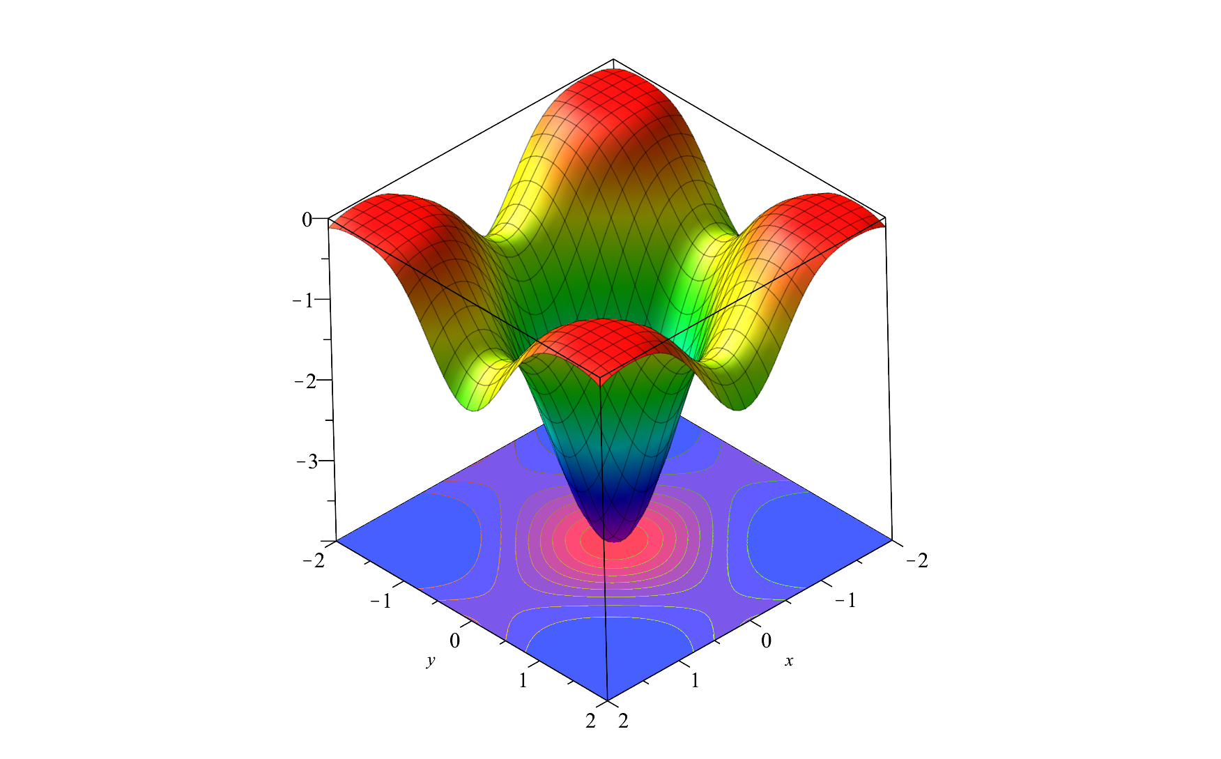
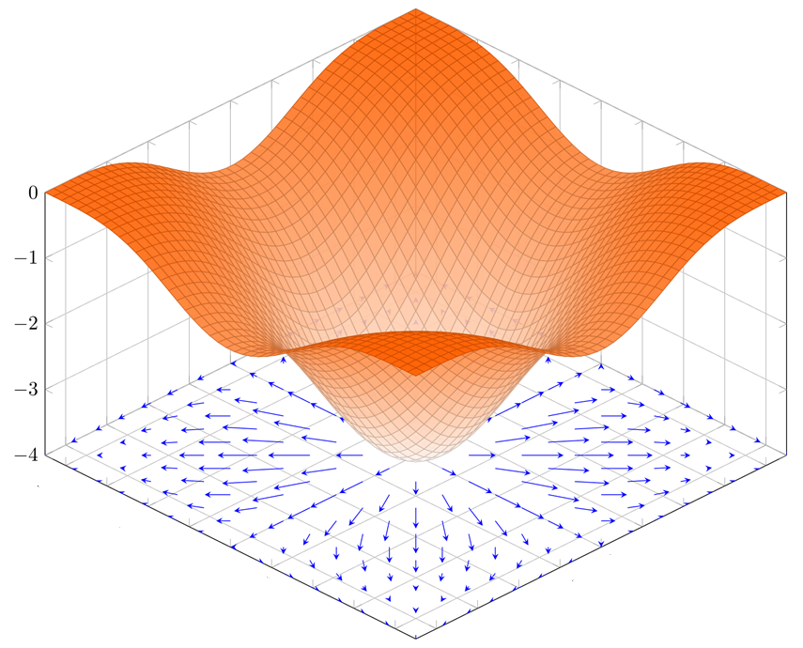
The Gradient is a vector field
The gradient is a vector field whose components are the partial derivatives of T(x,y).

Slide 7
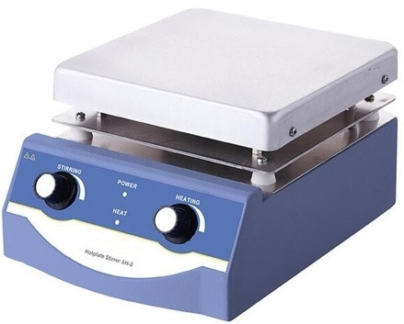
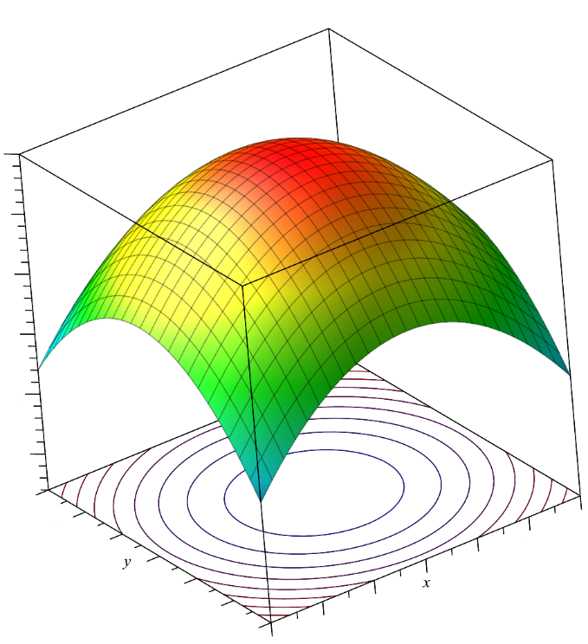
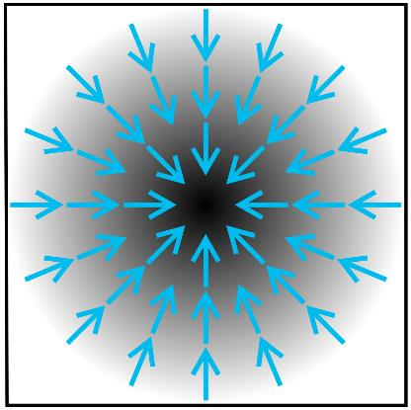

The temperature of Hot plate

Slide 8
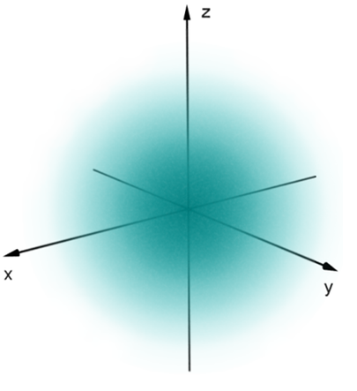
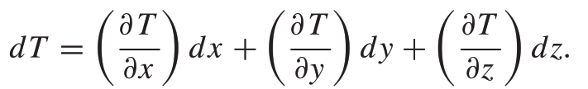
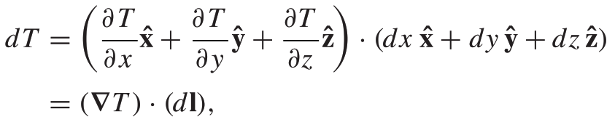
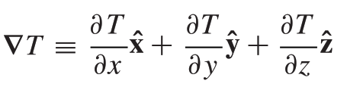
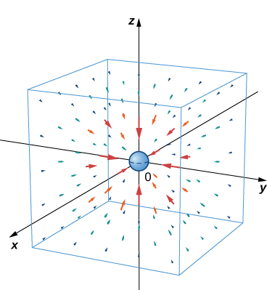
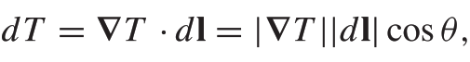
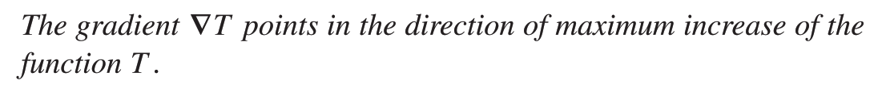
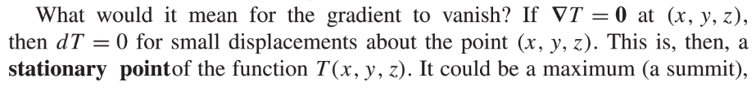
Gradient (3D)

Slide 9
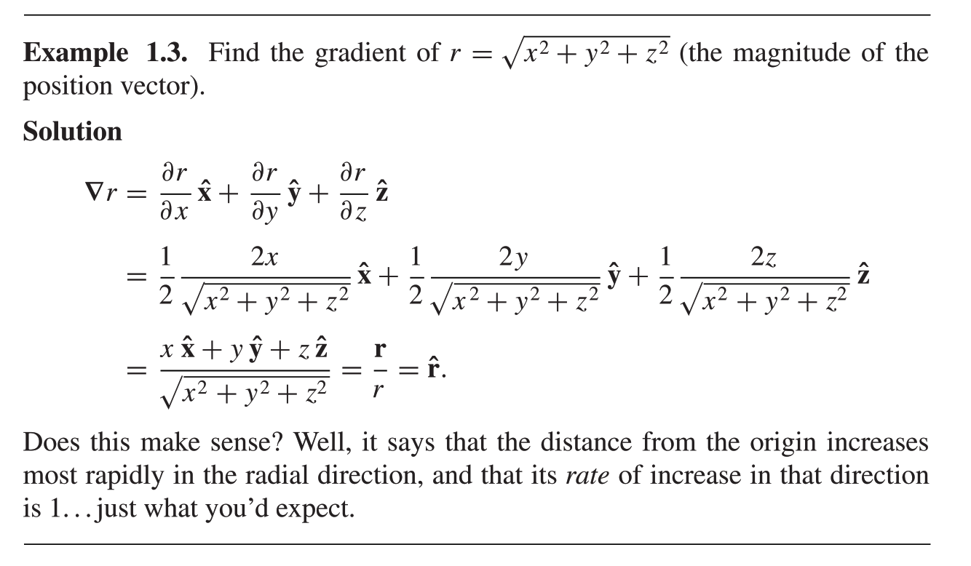
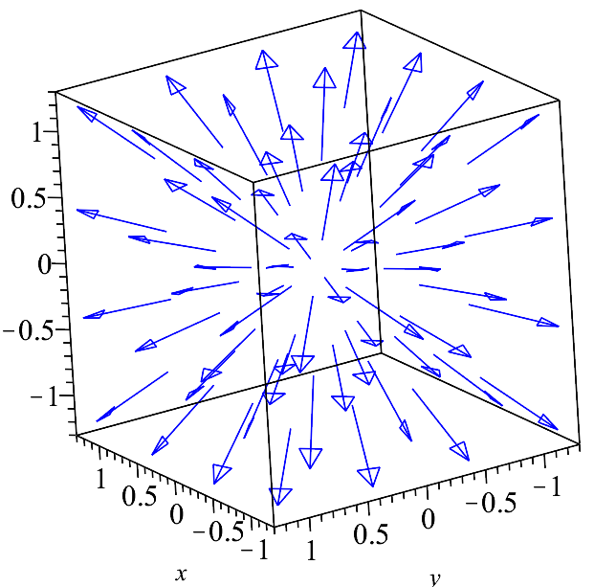

Slide 10
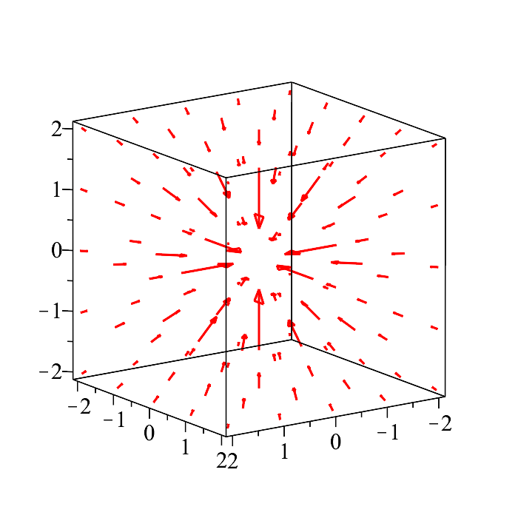
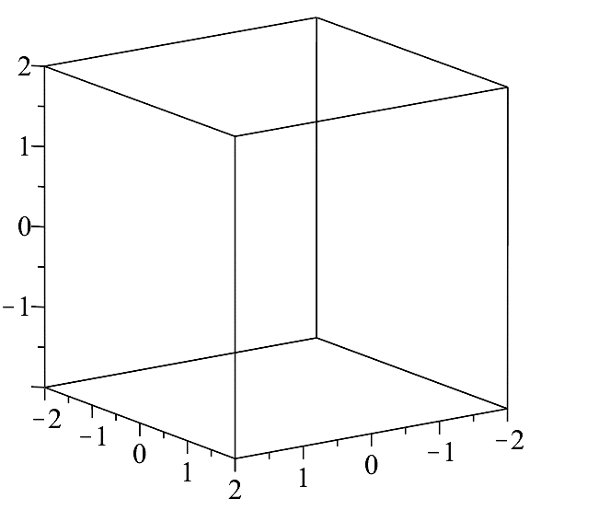
Example:

Slide 11
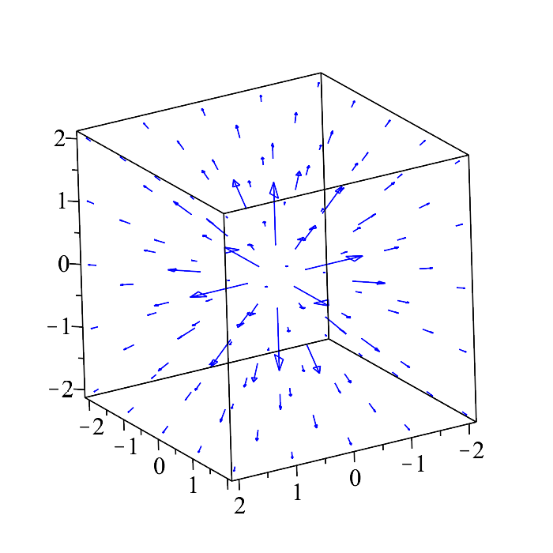
Example:

Slide 12
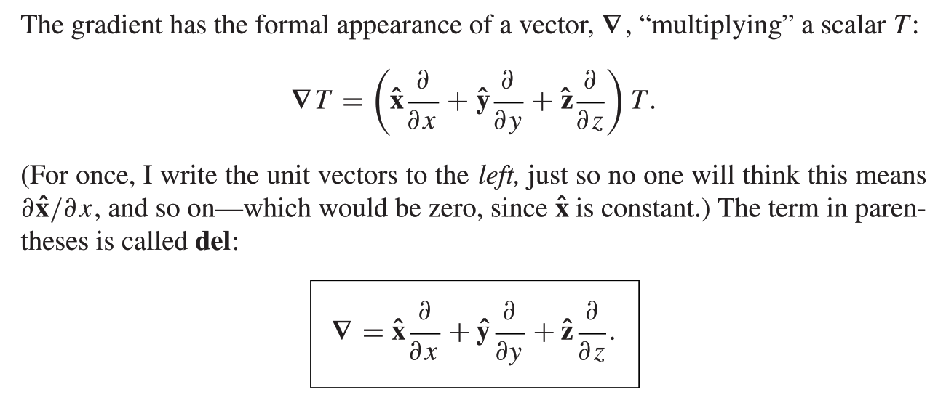
The Del Operator
Del is not a vector
∇ is a vector operator that acts upon T, not a vector that multiplies T
∇ mimics the behavior of an ordinary vector in virtually every way;
almost anything that can be done with other vectors can also be done with ∇, if we merely translate “multiply” by “act upon.”

Slide 13
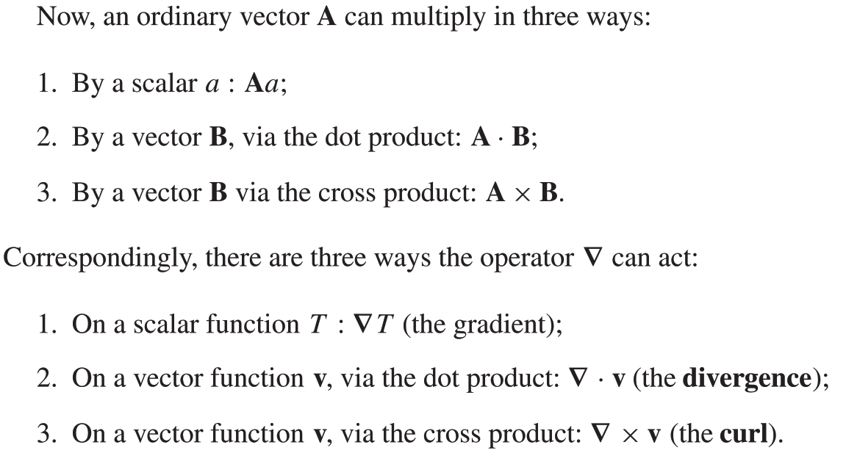
Tensor notation

Slide 14
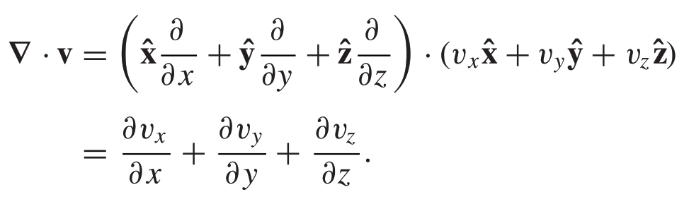
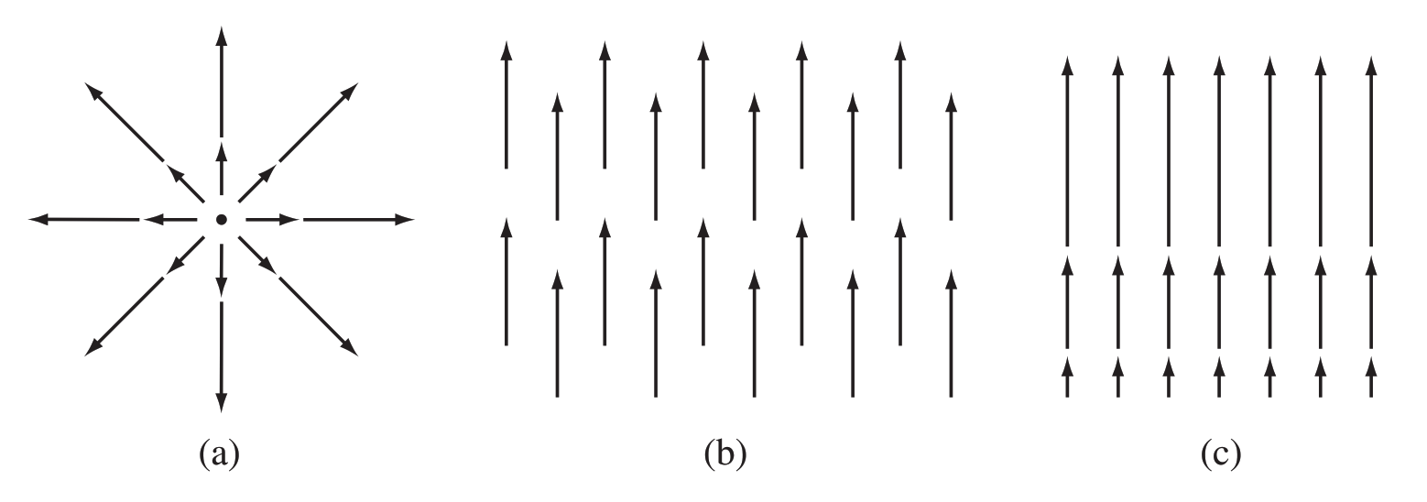
The Divergence
The name divergence is well chosen, It is a measure of how much the vector v spreads out (diverges) from the point in question.
has a large (positive)divergence (if the arrows pointed in, it would be a negative divergence),
)b( has zero divergence,
(c) again has positive divergence
V here is a function.
There’s a different vector associated with every point in space.
In the diagrams, we can only draw the arrows at a few representative locations.

Slide 15
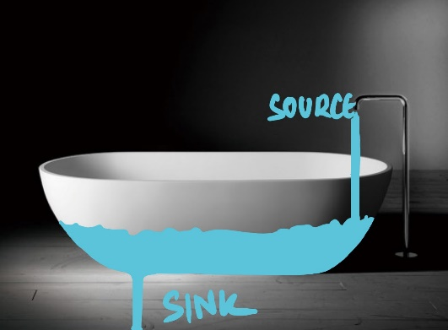
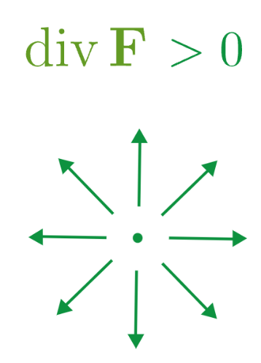
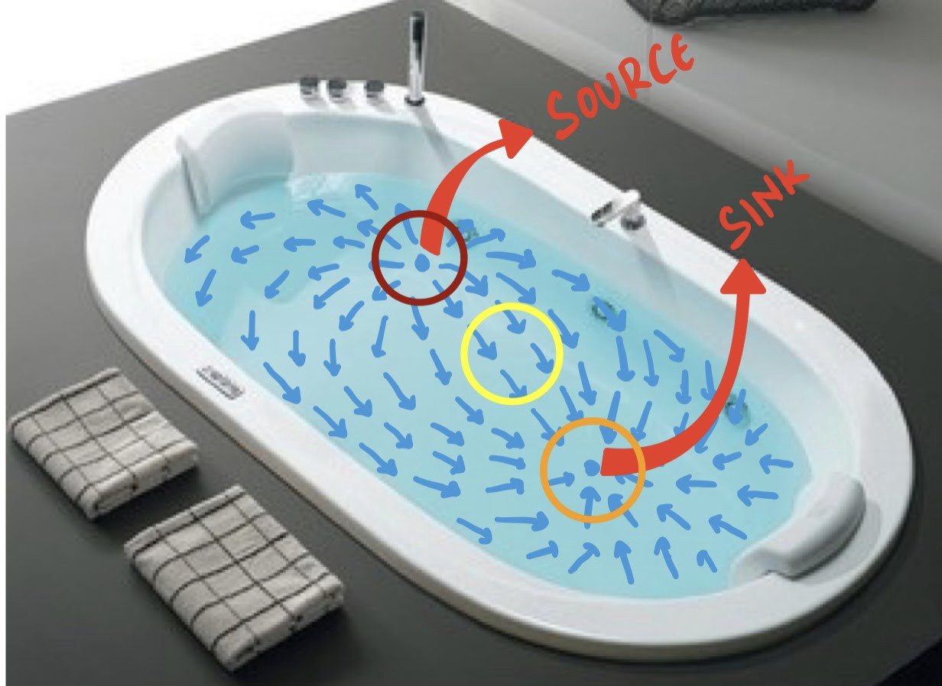
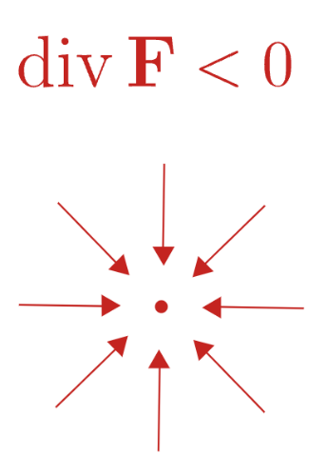
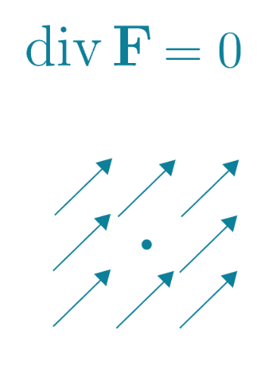

Slide 16
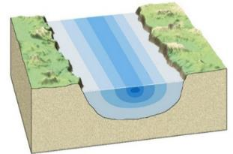
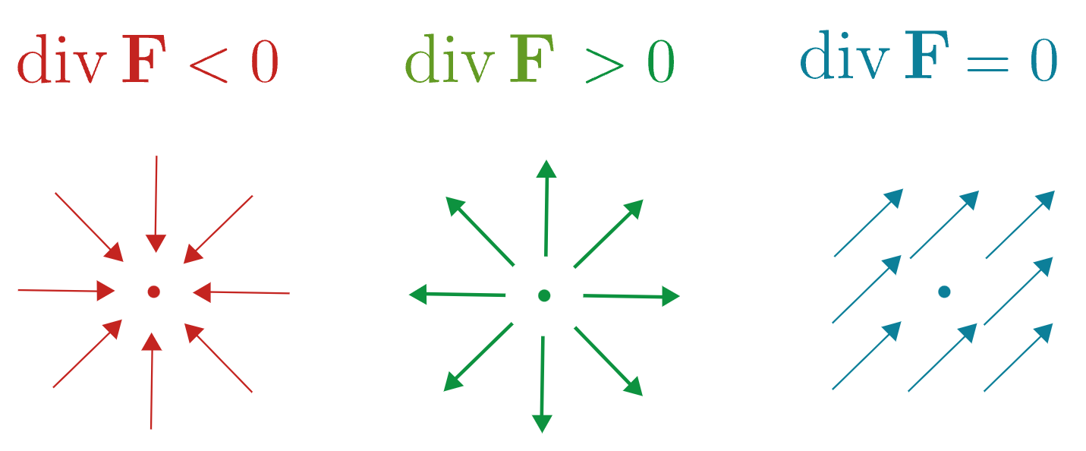
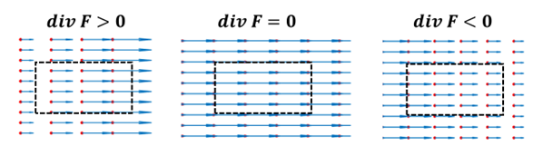

Slide 17
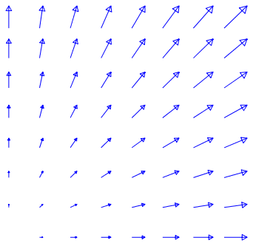
Tensor notation

Slide 18
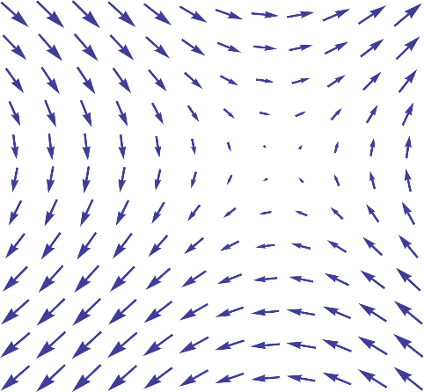
2D Divergence XY Plane
Y
X
Z

Slide 19
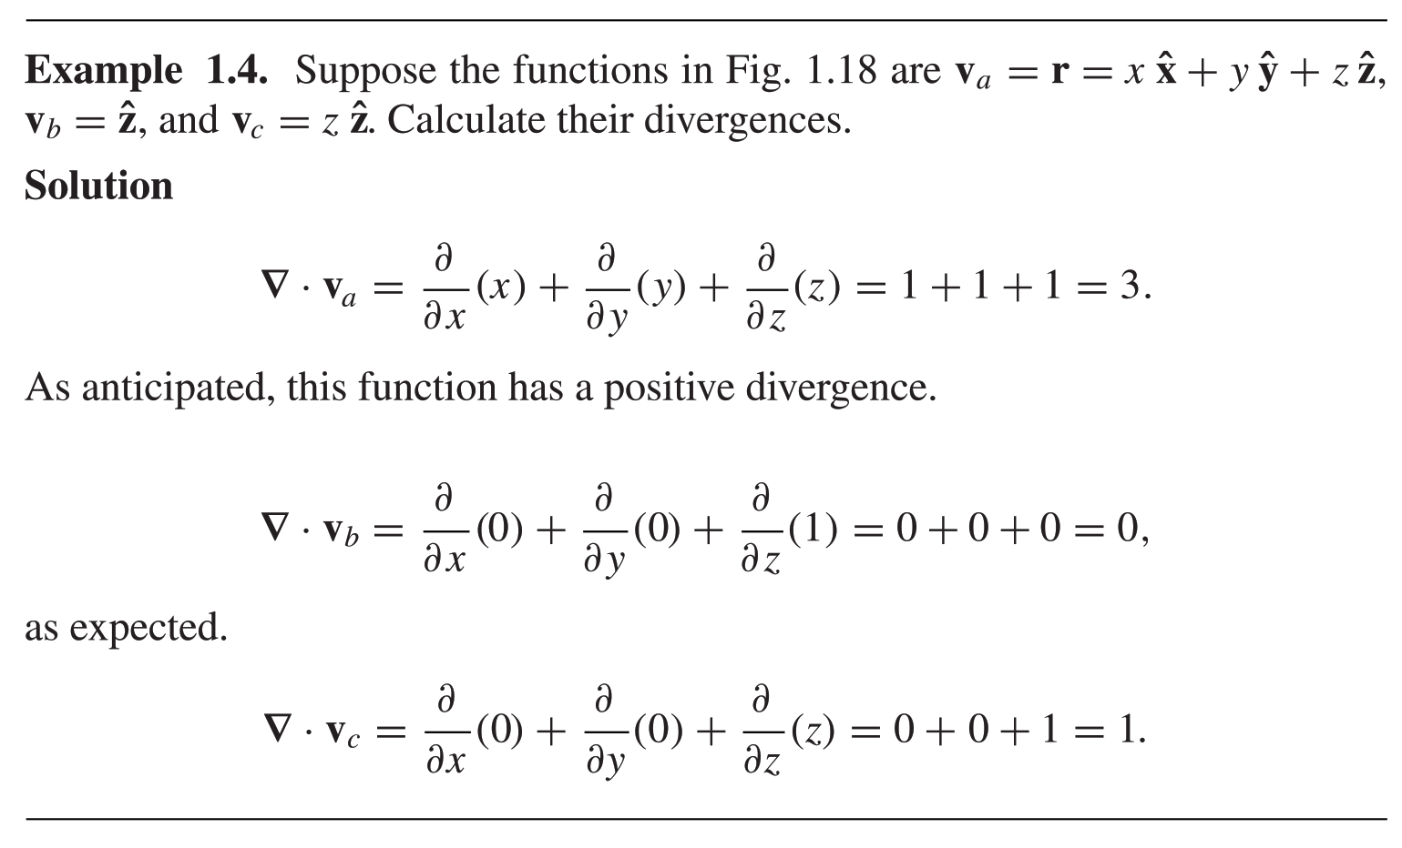
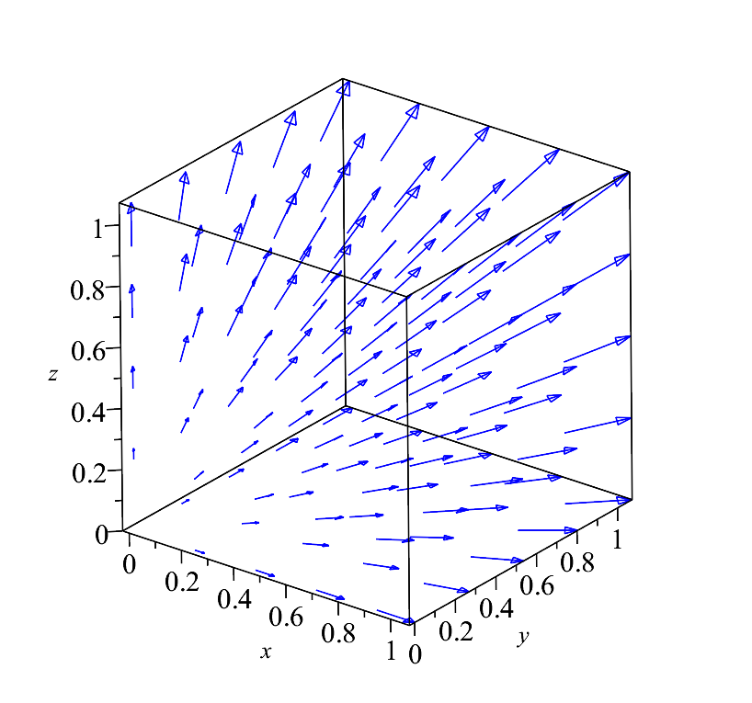
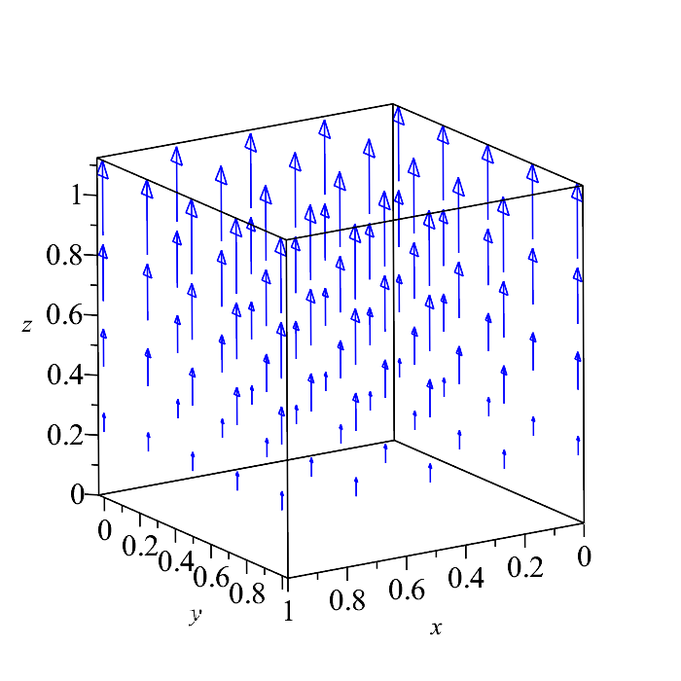
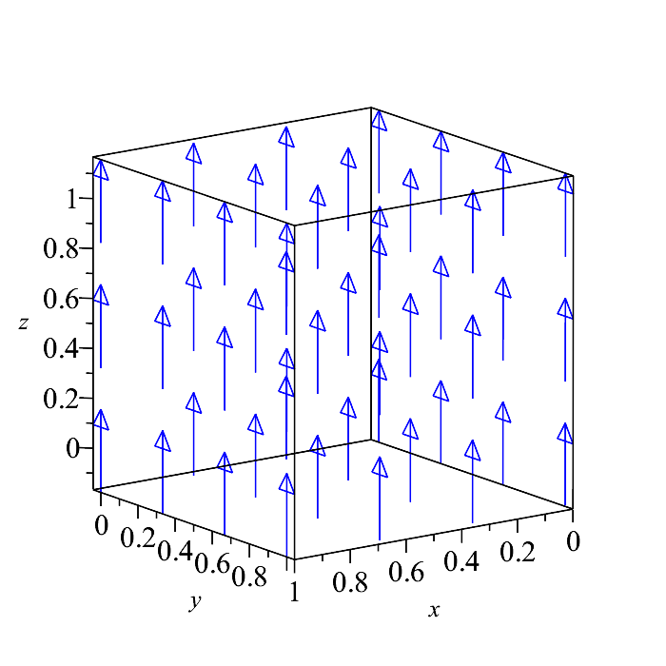

Slide 20
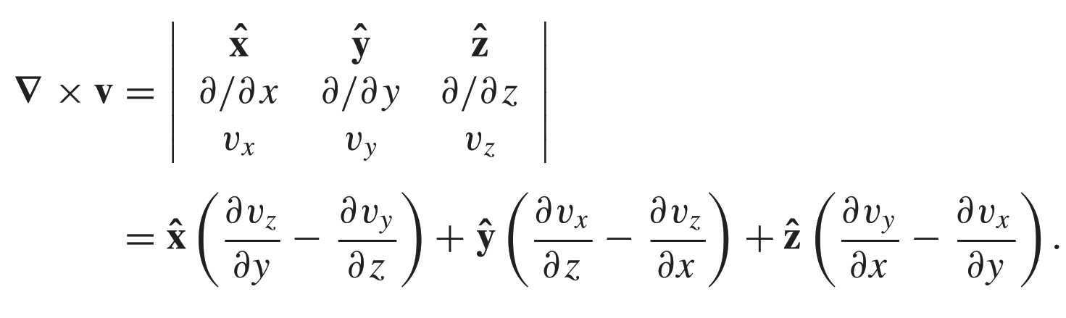
The Curl
Tensor notation
Geometrical Interpretation: The curl (∇ × v) is a measure of how much the vector v swirls around the point in question. Thus the three functions in bellow Fig. all have zero curl (as you can easily check for yourself.

Slide 21
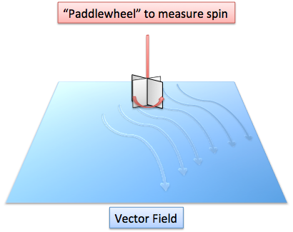
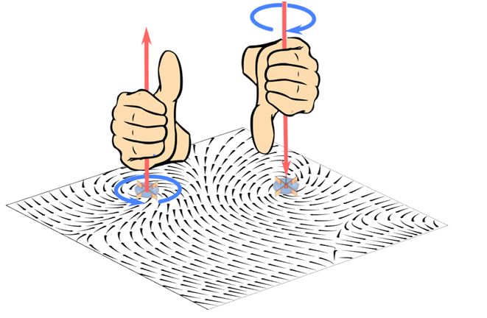
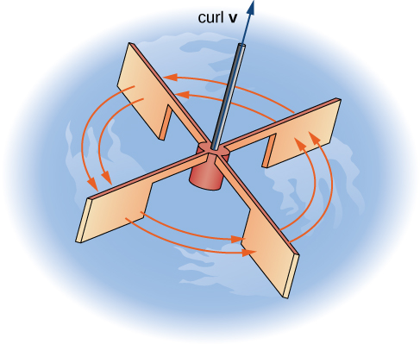
Imagine (again) you are standing at the edge of a pond. Float a small paddlewheel (a cork with toothpicks pointing out radially would do); if it starts to rotate, then you placed it at a point of nonzero curl. A whirlpool would be a region of large curl.
Curl of a vector is a vector
The above field have a substantial curl, pointing in the z direction,
as the natural right-hand rule would suggest.

Slide 22
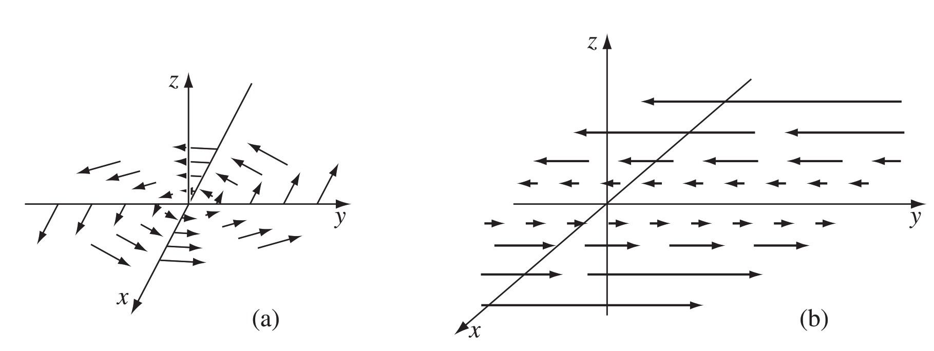
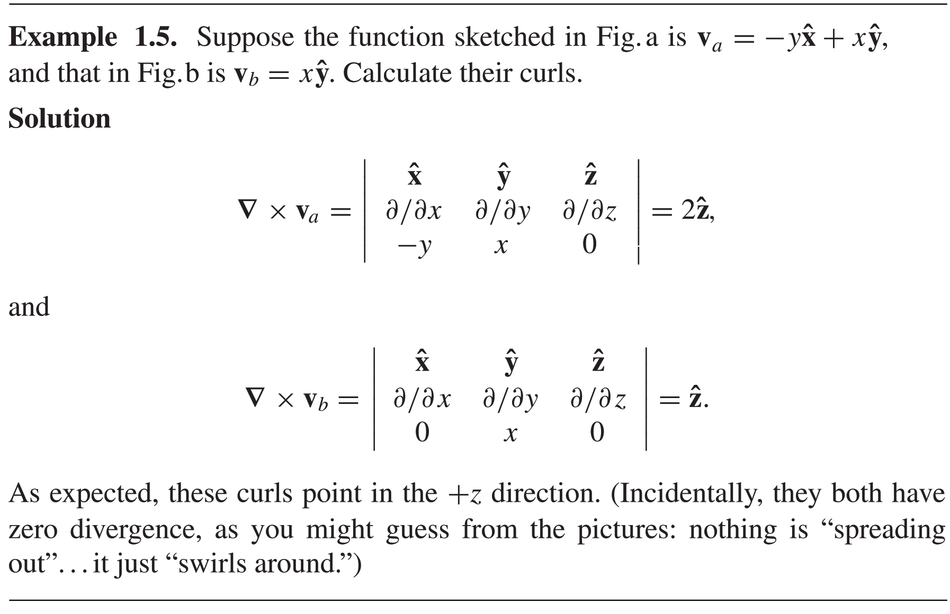

Slide 23
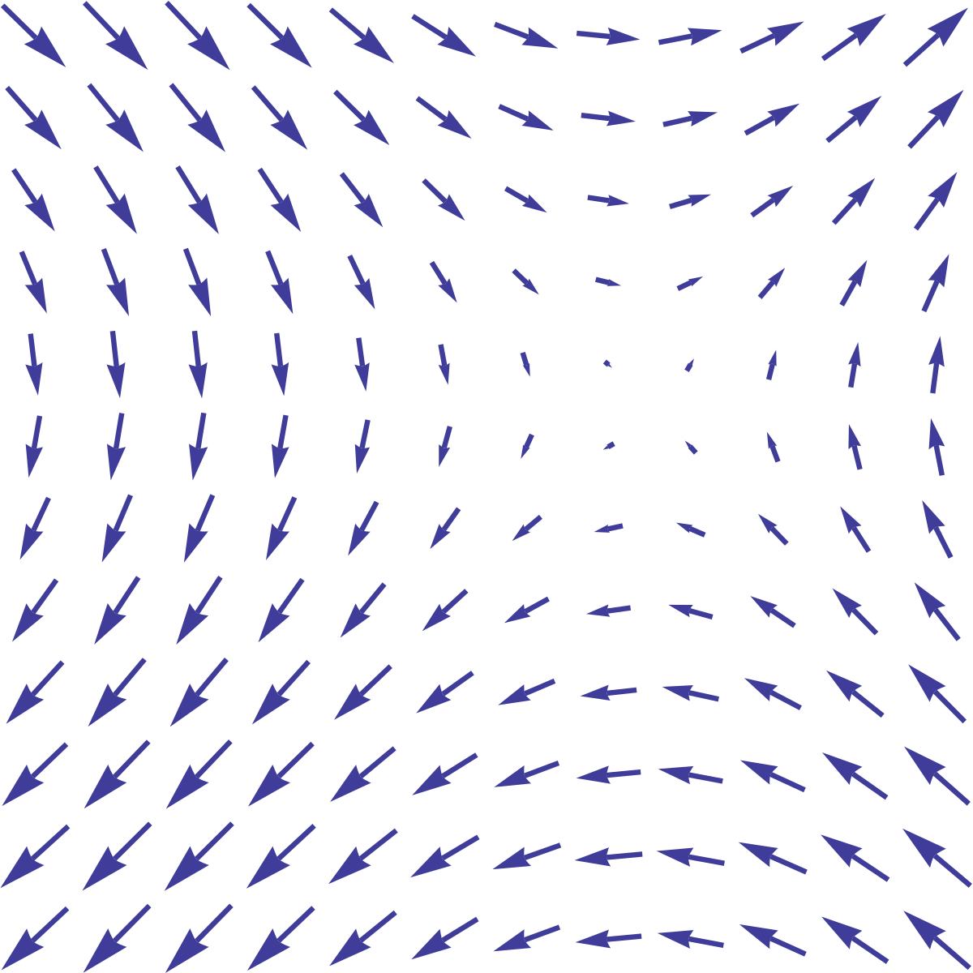

Slide 24
Y
X
Z

Slide 25
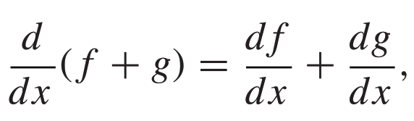
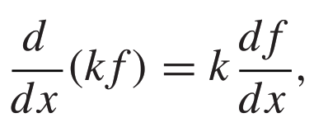
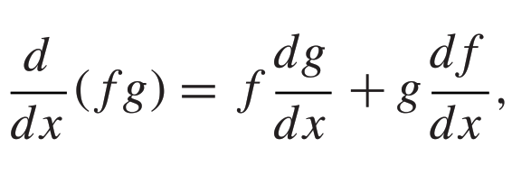





Product Rules

Slide 26


Slide 27

The proofs come straight from the product rule for ordinary derivatives. For instance,

Slide 28


Slide 29

Second Derivatives
The gradient, the divergence, and the curl are the only first derivatives we can make with ∇;
By applying ∇ twice, we can construct five species of second derivative:

Slide 30


Laplacian
The Laplacian of T, which we write for short:
Tensor notation
Laplacian of a scalar T is a scalar
The Laplacian of a vector:
a vector quantity whose x -component is the Laplacian of vx , and so on

Slide 31



Slide 32

(3) ∇(∇·V) seldom occurs in physical applications,and it has not been given any special name of its own (it’s just the gradient of the divergence.)
Notice that ∇(∇ · v) is not the same as the Laplacian of a vector:
∇²V = (∇ · ∇)V ²≠ ∇(∇ · V).

Slide 33


